Slide 1
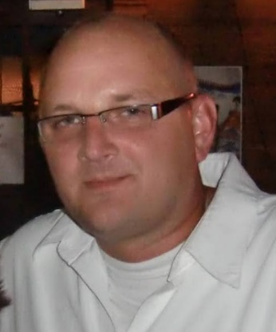
Free Live 1-Hour Webinar
Managing File Permissions
In this free 1-hour live webinar, you will get an overview of how to manage and change file permissions in SUSE Linux Enterprise Server (SLES) 15.
You will learn:
File permissions and ownership
File/Directory Models (Permissions)
Modifying File/Directory Modes and Ownership
umask
Join us on Thursday July 8, 2021
Register Today:
Option 1 - 13:00 CEST
Option 2 – 18:00 CEST
Presented by:
Aaron Southerland, SUSE Certified Engineer

